Slide 1
Module #3
Start
Reporting Academic Misconduct
By: Miko Nino

Slide 2
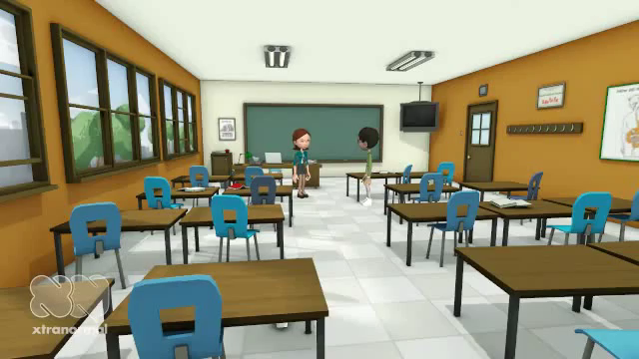

Slide 3

Have You Experienced This?
Yes
No

Slide 4

Great!
You are somehow familiar with the implications and consequences of academic misconduct.
Facing situations in which we witness academic misconduct is common, so being prepared is important.
What would you have to do in an scenario of academic misconduct? Do you know how to proceed? Think about it, before moving to the next slide.

Slide 5

Don’t Worry!
Some students have never witnessed or experienced situations of academic misconduct, but it does not mean it cannot happened.
Before moving to the next slide, think about this:
What instances of academic misconduct do you know?
How would you report academic misconduct if you ever face it?

Slide 6

What Other Students Have Said…
“Academic misconduct should be reported immediately to the Graduate School…”
“It is important to verify and double check if a situation is academic misconduct, before reporting it.”
“I would consult with my advisor, mentor, or someone with more experience to see what to do.”
“I am aware that there is a form that should be filled out in order to formally report academic misconduct.”

Slide 7
What Other Students Have Said…
“I know plagiarizing a paper is a serious academic misconduct, as well as cheating. They should be immediately reported to the Graduate School.”
“I am aware that falsification and sabotage are some types of academic misconduct. I am not sure what I would do if I see someone doing it. I think I would ask a professor or expert for guidance.”
“Plagiarism is a type of academic misconduct. I know there is a form online to report it.”

Slide 8

If you need to report academic misconduct, what information do you need?

Slide 9

Goals
The main goal of this tutorial is to give you pertinent information to recognize, categorize, and report academic misconduct.
By the end of this module, you should be able to:
Recognize if a suspected behavior is a type of academic misconduct

Slide 10

Goals
Categorize violations of the Graduate School Honor Code
Locate and prepare the Graduate School report form within 10 business days, upon deciding to report an instance of academic misconduct
Send the report form and other attachments to the authorities and follow up with it

Slide 11
About this Module…
This is a self-paced module that can be completed at your own leisure
In order to navigate the tutorial, follow the prompts displayed in the screen and at the bottom of the page
Throughout the module, you will be asked some multiple-choice questions
At the end of the tutorial, you will be required to prepare an academic misconduct report

Slide 12

Overview
In this module, we will cover the following topics:
Recognizing academic misconduct
Types of academic misconduct
Steps to report academic misconduct
Preparing a report form

Slide 13

Check this Scenario Out!

Slide 14
Questions?
What type of academic misconduct was portrayed in the video?
What are the examples of this academic misconduct listed in the video?
How do you feel about it?

Slide 15

Cheating
“Cheating is defined to encompass the giving or receiving of any unauthorized aid, assistance, or unfair advantage on any form of academic work,” not limited to coursework.
The most frequent referrals involve cheating on take-home and/or open-book exams.
The video presented examples of cheating. What are those?

Slide 16

Important!
It is important that instructors clearly state what is allowed and not allowed during any academic work, and students should make sure their instructors do so.

Slide 17
Types of Academic Misconduct
Cheating
Click here to find out more about other types of academic misconduct

Slide 18
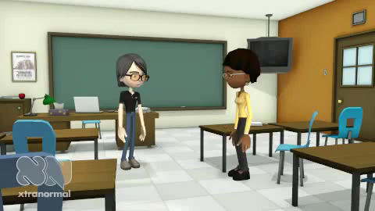
Now, take a look at this…

Slide 19
Questions?
Why is the student facing academic misconduct?
What type of academic misconduct is displayed in the video?
What do you think should be done in a situation like this?

Slide 20
Plagiarism
“Plagiarism is a specific form of cheating. It is defined as copying the language, structure, idea and/or thoughts of another and claiming or attempting to imply that they are one's own work.
It includes omitting of quotation marks when references are copied directly, improper paraphrasing, or inadequate referencing of sources.”

Slide 21
Plagiarism
The video presented a clear example of plagiarism and steps to fight it
In the past, students found guilty of plagiarism have explained that they could not find a better way to express the ideas than the words chosen by the original author; therefore, they thought it appropriate to copy or only slightly modify the words used in the original source. This often happens when the students involved do not have good English skills and/or when the topic is quite technical in nature.

Slide 22
Types of Academic Misconduct
Cheating
Plagiarism
Click here to find out more about other types of academic misconduct

Slide 23
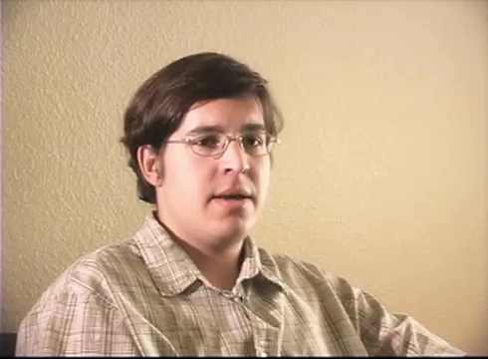
Now, take a look at this

Slide 24
Questions?
What type of academic misconduct is represented in the video?
What do you think are the consequences of this academic misconduct?
How would you have reacted under such a circumstance?

Slide 25
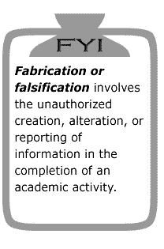
Falsification
“Falsifying any circumstance relevant to the student's academic work.” Examples include acts such as forgery or changing academic documents and lying.
Also, altering data can be considered falsification

Slide 26
Types of Academic Misconduct
Cheating
Plagiarism
Falsification
Click here to find out more about other types of academic misconduct

Slide 27

Read the Following Scenario
Jenna is concerned because her Biology research experiment did not have the results she was expecting. She had been working in Dr. Nino’s project for several months and the experiment was going to be a substantial part of her dissertation. With the current findings of the experiment, the completion of her dissertation is going to be significantly delayed, since she will have to repeat the experiments with different variables.

Slide 28
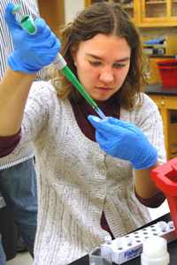
On the other hand, Michelle, the other research assistant in Dr. Nino’s laboratory is making significant progress towards her dissertation and her current experiment is about to conclude with excellent results.
Dr. Nino mentioned the possibility of a tenure-track teaching position in the School of Biology and that he is willing to recommend either Jenna or Michelle, whoever defends their dissertation first.
The unexpected results in her experiment would put Jenna in disadvantage, so she decided to add a variable to Michelle’s experiment (e.g. water), so she could also have trouble in her experiment.
Unfortunately, Jenna forgot that the lab had security cameras.

Slide 29
Questions?
What type of academic misconduct was presented in the video?
Why is it considered academic misconduct?
What should you do if you witness such a behavior?

Slide 30
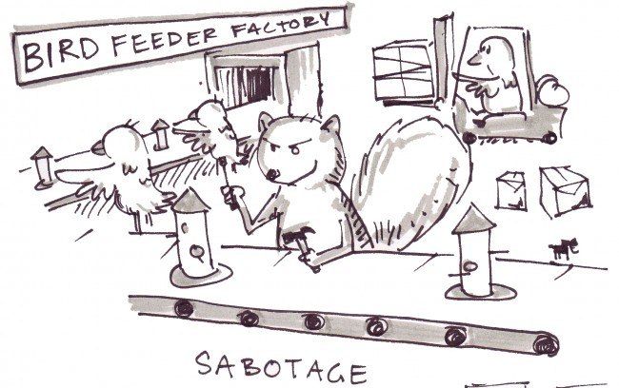
Academic Sabotage
Academic sabotage is purposeful vandalism directed against any academic endeavor or equipment. It includes, but is not limited to, the destruction or theft of written material, laboratory or field experiments, equipment used in teaching or research, or computer files or programs. Unauthorized tampering with computer programs or systems shall constitute a violation.

Slide 31
Academic Sabotage
Academic sabotage includes deliberately crashing or attempting to crash a computer system or the use of files intended to cause or actually causing computer systems to behave atypically, thereby impeding another person's or group's efforts. In particular, knowingly infecting any system with a virus, worm, time bomb, trap door, Trojan horse, or any other kind of invasive program shall be considered a serious violation. Note that violations under this category may also lead to University judicial action or to criminal suits charged by the University.

Slide 32
Types of Academic Misconduct
Cheating
Plagiarism
Falsification
Academic Sabotage
These are the four types of academic misconduct

Slide 33
So, What is Next?
Now that you are aware about the four types of academic misconduct and you can recognize them, think about the following question, before going to the next slide:
What should you do once you face or witness a situation of academic misconduct?

Slide 34
What Other Students Have Said…
“I will contact the instructor of the course and the Graduate School if I see academic misconduct”
“I think the best thing to do is contact the Graduate School. Their website has information on how to report academic misconduct”
“There is the Graduate School Honor Code that explains how to report academic misconduct”
“First, I will make sure the incident is actually academic misconduct before reporting it. Then I will follow the procedures of the Graduate School Honor Code. I heard there is a form that should be completed”

Slide 35

Reporting Academic Misconduct is not Optional!
It is the obligation of all members of the academic community to report alleged violations of the Graduate Honor Code. According to the GHS Constitution, “reporting the observance of a Graduate Honor Code violation shall not be optional; it shall be mandatory”.

Slide 36
Think About This…
Are you familiar with the Graduate School at Virginia Tech’s policies to report academic misconduct?
What are the requirements and steps to report academic misconduct?

Slide 37

Suspected violations of the Graduate Honor Code must be reported within ten (10) University business days after the date of discovery. Only under very special circumstances shall exceptions to this policy be granted, and then only at the discretion of the Chief Justice and the Graduate Honor System Advisor.

Slide 38
When Reporting…
Violations should be reported to the Chief Justice or the Graduate Honor System Advisor in writing, using the report form.
Submit the form and relevant attachments to the Graduate Honor System, c/o Graduate School (0325), 117 GLC.
The receipt of an Honor System referral is acknowledged in writing by a letter to the accused student(s) and the referrer.

Slide 39
How are These Policies Different from Those at Other Institutions?
What do you Think About Them?

Slide 40
Step 1
First, you should be able to identify and recognize if a scenario is an instance of academic misconduct
You can help yourself consulting the Graduate School Honor Code that can be found in the Graduate School website
Also, you can contact the Chief Justice and the Graduate Honor System Advisor
Feel free to contact professors, mentors, or other experts if you still in doubt whether a situation is academic misconduct or not.

Slide 41

Step 2
Once you know the scenario is academic misconduct, you should be able to categorize it. The four examples previously displayed in this module will help you categorize instances of academic misconduct
Decide whether the instance is cheating, plagiarism, falsification, or academic sabotage
The Graduate School Honor Code and the Graduate School can help you, if still in doubt

Slide 42
Step 3
Now, it is time to fill out the report form
This form can be found in the Graduate School website
Make sure it has no spelling or punctuation errors
Go to the next slide and take a look

Slide 43
Can you Find the Graduate School Report Form?
Take some time and locate the form.
Did you Find it?
Go to next slide when ready

Slide 44
Report
Form

Slide 45
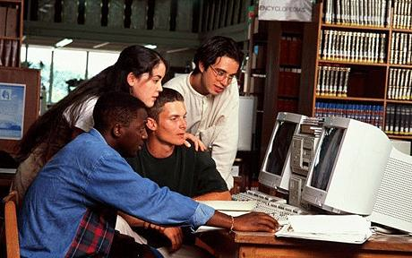
Now, let’s practice
Assume you are taking the course Astrology 101 and one of your best friends, John Smith, told you he does not have time to write the final research paper for the course. He told you about a website where it is possible to find several papers in astrology.

Slide 46
Since this assignment is not going to be electronically submitted, John told you it is very hard for the instructor to realize if the paper was downloaded from the Internet or not.
A couple of weeks later, John sits next to you in the computer lab and show the website, as he downloads the paper he is going to submit for the class.
As John prints the paper, he asks you to keep the situation secret, stating that only you as his best friend, knows about it.

Slide 47
What are Your Thoughts?
Is this instance academic misconduct or not? Why?
Think about the information provided in this tutorial when elaborating your answer. Once you are ready, go to the next slide.

Slide 48
Yes, it is Academic Misconduct!!!
What type of academic misconduct it is?
What should be role in this situation? Should you ignore it for being John’s best friend or should you report it?

Slide 49

It is Plagiarism!
Using somebody else’s work and submitting it as your own is plagiarism and is a serious instance of academic misconduct
Regardless of the individual who engaged in academic misconduct, it is your responsibility to report it to the Graduate School.

Slide 50
Now, what?
Do you remember the steps that should be followed to report academic misconduct?
Using the information from this tutorial, please proceed to hypothetically report this instance of academic misconduct.
Once you are ready, go to the next slide

Slide 51
How Did you Do?
If you did things right, you should have gone online and located the report form
Also, you should have completed it online report form
Go to the next slide to see how your form should look like

Slide 52
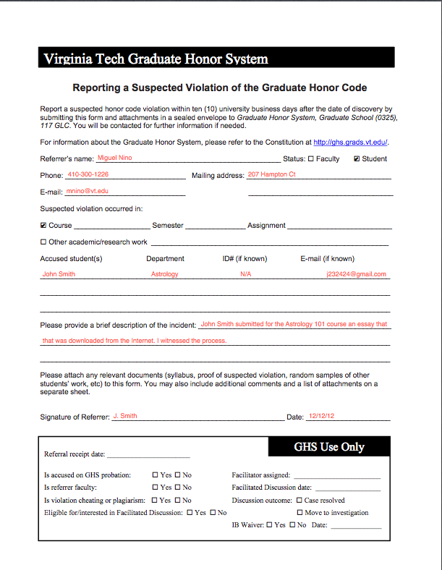

Slide 53

The Evidence
Sometimes reporting the incident of academic misconduct is not enough and you need to support your claims with evidence.
What do you think can be good evidence to attach to the report form? Let’s use our previous scenario. Go to the next slide once you are ready.

Slide 54
Some Relevant Evidence
Based on the previous scenario, these can be possible evidence you can attach when you report it:
Links to the website where the paper was found
A printed copy of the plagiarized paper
A copy of the syllabus for the class

Slide 55
Other Examples
In general, some relevant evidence can include:
Electronic conversations
Syllabi
Printed assignments
Pictures
Exams

Slide 56
Last, but not Least…
Remember to submit your evidence:
Graduate Honor System, c/o Graduate School (0325), 117 GLC.
And…include all the relevant evidence that you find.
Finally, contact them a couple of weeks later, if they have not done so, to follow up.

Slide 57
Your Assessment
Now, let’s go for one last assignment to test your knowledge:
You work with Dr. Brown in his lab, running an experiment about motivation in children. One of your coworkers is taking a class in educational psychology and he has to present a literature review as a final assessment for his course. Going through some materials, he finds in the lab a literature review you conducted for Dr. Brown two years ago.

Slide 58
Your coworker decides to use this literature review for his class, since nobody is familiar there with the job that is conducted in the laboratory.
Please:
Identify if this is an instance of academic misconduct and categorize it
Prepare a report
When ready, go to the next slide

Slide 59
Reflection
You have learned in this tutorial about academic misconduct and how to report it.
It is important to recognize it, categorize it, and properly report it.
Also, keep in mind, it is important to understand that reporting academic misconduct is not optional.

Slide 60
Do you Feel Ready Now to Report Academic Misconduct?
You can always retake or consult this tutorial if you have further questions
Keep in mind that the Graduate School is available to offer you guidance if you need help or assistance
Text for this tutorial has been taken from the Virginia Tech Graduate School website

Slide 61

Congratulations!
You have completed this module on reporting academic misconduct at Virginia Tech.
Your knowledge about academic misconduct is relevant for the academic community and the Graduate School

